Slide 1

Semantic Web & Linked Data
Group 12:
Lucía Fernández Molleda
Diego Conde Herreros
Belén Ferrón Hurtado
David Jiménez Lamas

Slide 2
Index
Introduction
Datasets
Ontology
Data treatment
Linked data
Web application
Demo

Slide 3
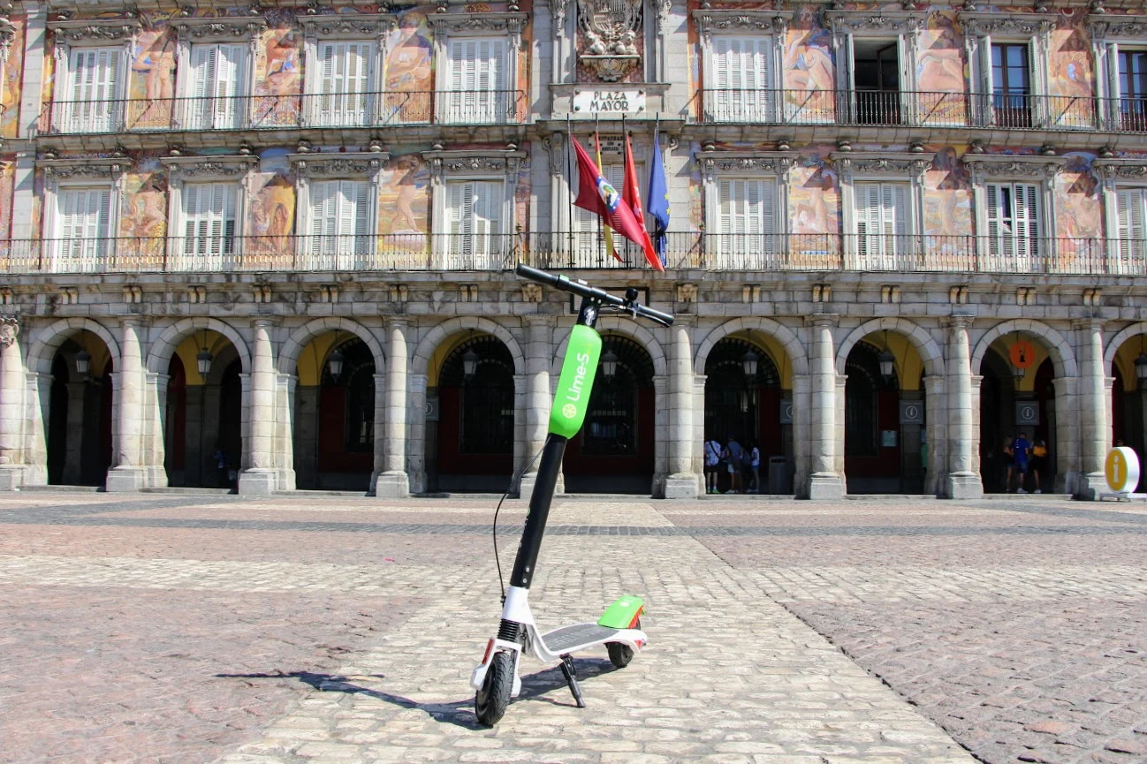
Introduction
MadScooters allows the user to view how many scooters are available in a specific district or area as well as how many per company are there.

Slide 4
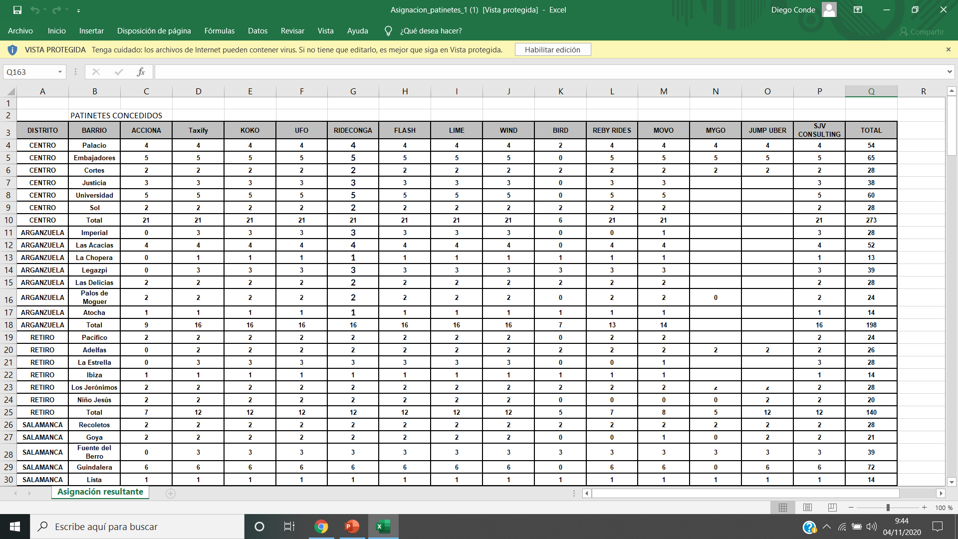
Datasets
The only dataset that has been used is AsignacionPatinetes
AsignacionPatinetes can be used for commercial and non-commercial purposes
There is no column dedicated to Availability and Company.

Slide 5
Ontology: Previous Ontology
PLACE
hasAvailability
AVAILABILITY
hasCompany
COMPANY
hasNeighbourhood
quantity
hasDistrict
DISTRICT
NEIGHBOURHOOD
xsd:integer

Slide 6
Ontology: Updated Ontology
xsd:integer
quantityAcciona
PLACE
quantityTaxify
xsd:integer
hasNeighbourhood
hasDistrict
DISTRICT
NEIGHBOURHOOD

Slide 7

Data treatment
The tool employed for this task is OpenRefine.
Creation of new columns so that the csv adapts to our ontology.
Usage of number facets in availability columns to substitute empty cells with 0.

Slide 8

Linked data
The following columns of AsignacionPatinetes have been linked with WikiData: District & Neighbourhood.
There were three columns that didn't automatically reconcile (El Pilar, Ambroz, Salvador).

Slide 9


Web Application
Frontend: HTML, CSS y JS
Backend: Python + Flask

Slide 10
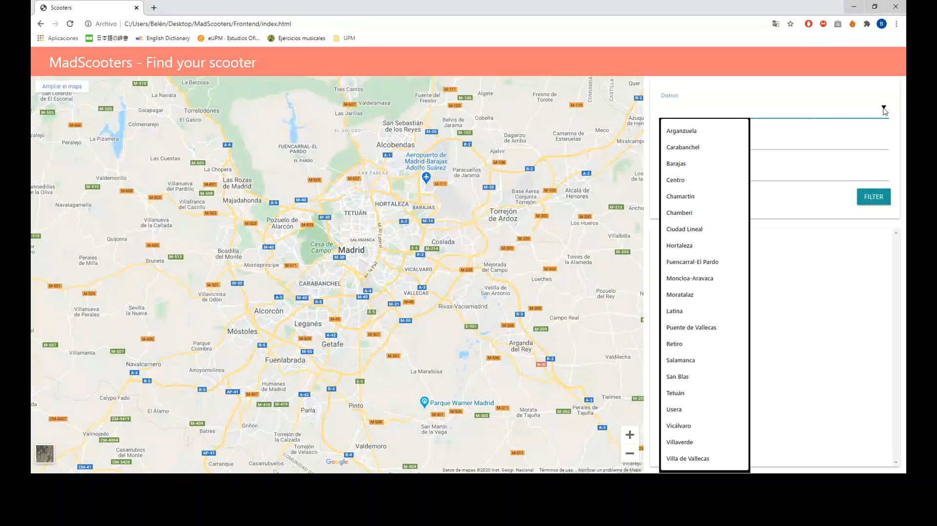
Demo

